Slide 1
Navigating Tableau

Slide 2

Example of a Story
replicating the famous 1854 visualization about the spread of cholera
A story is a way to explain your data in a systematic way
https://public.tableau.com/s/gallery/mapping-1854-cholera-outbreak

Slide 3
Navigating the Cholera Story
On the left hand side you’ll see a list of the dashboards and worksheets
Cholera cases tab (worksheet)
Geographical representation
See the underlying data

Slide 4
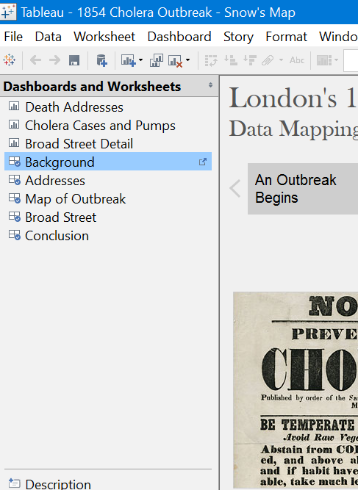
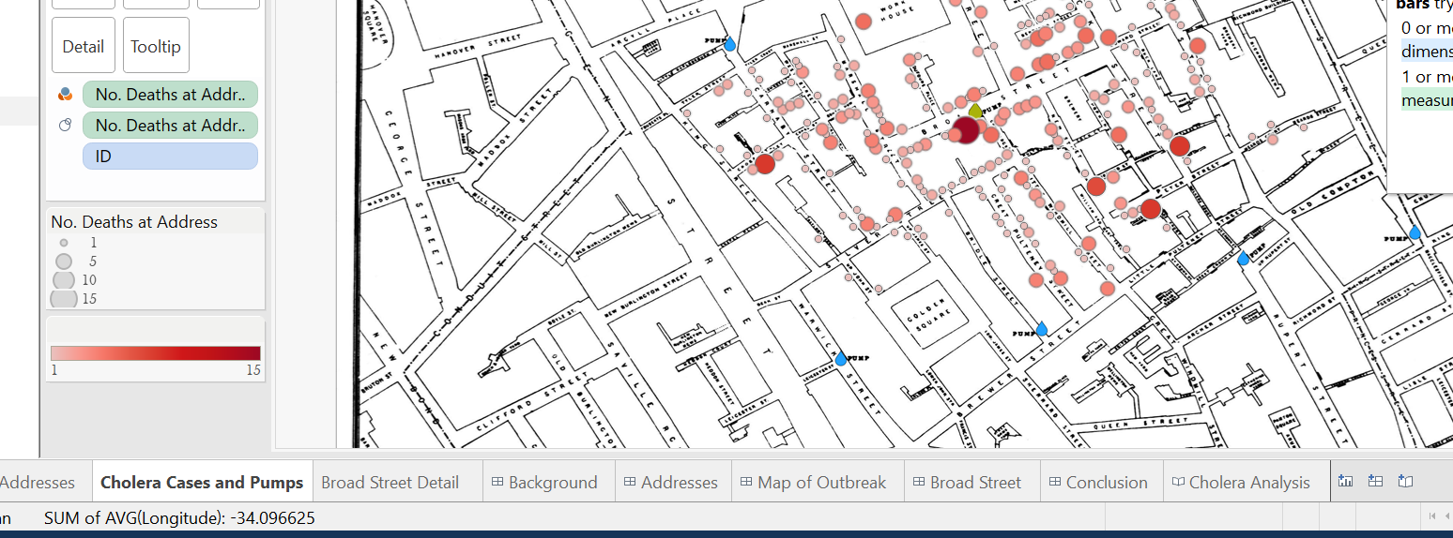

Slide 5
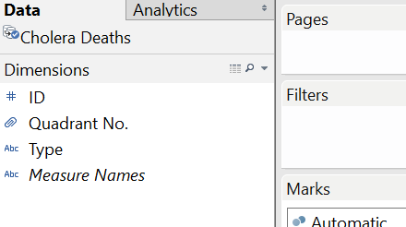
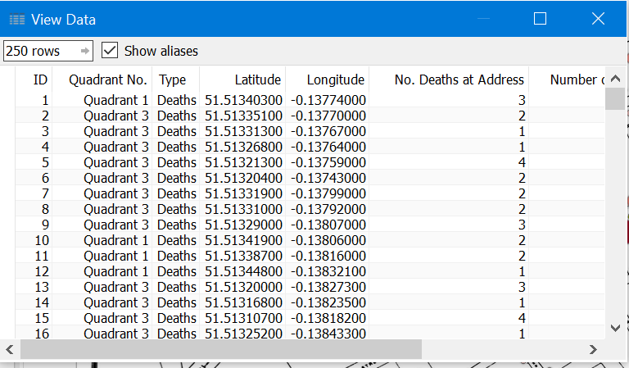

Slide 6
Navigating Tableau
As you can see, it is not that hard to make a story
Two skills required
Choosing the right visualization to deliver your story
Making the right visualization
So far, we know the basics of how to put a visualization together
Next step, dive in deeper in Tableau world

Slide 7
Data Categories
Dimensions
Dimensions help to categorize the data.
are qualitative and Do not total a sum
For example, sales region, employee, location, or date
Measures
Measures help to determine the scale of a category
numerical values that mathematical functions work on
For example, a sales revenue column. You can find out a total or average the data
Are all numbers measures?
No. Not all columns containing numerical data are considered measures.
A satisfaction rating, makes more sense as a dimension.
a certain product line received 10,000 stars in total is not particularly interesting. However, knowing which products in that line received the most 5-star ratings is useful.

Slide 8
Data Types
Data Type | Description | Example | Sign in Tableau
STRING | Any sequence of zero or more characters. They are enclosed within single quotes. The quote itself can be included in a string by writing it twice. | 'Hello' 'Quoted' 'quote' | ABC
NUMBER | These are either integers or floating points. It is advised to round the floating point numbers while using them in calculations. | 3 142.58 | #
BOOLEAN | They are logical values. | TRUE FALSE | T|F
DATE & DATETIME | Tableau recognizes dates in almost all formats. But in case we need to force Tableau to recognize a string as date, then we put a # sign before the data. | "02/01/2015" "#3 March 1982" | Calendar icon
Coordinates | Used for map plotting | Lon, Lat, countries, cities, zip code | Small globe

Slide 9
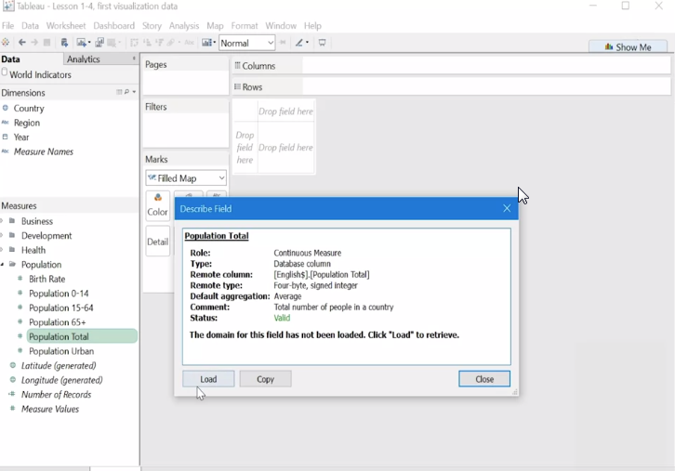
Under the Variables Hood
Pick a variable, right click -> Describe
-> load will give you the range of the columns

Slide 10
Shelves & Cards

Slide 11
Shelves & Cards
we have the shelves (or cards).
A view can be built by dragging and dropping fields from the data window into the canvas directly, or onto the shelves.
the Columns shelf and the Rows shelf (drag Internet Usage to Columns and years to Rows)
the Pages shelf (topic for later)

Slide 12
Shelves & Cards
Filter shelf – this is an important feature that you are likely to use a lot
Drag Segment to Filters as an example, and then Show Filter (formerly Show Quick Filter)
If you don’t want the “All” option for some reason, just click the Quick Filter’s drop-down menu and look under Customize.
Marks Card
The Marks Card is made up of several other shelves, each of which can have fields placed on them and can be clicked on to edit their characteristics

Slide 13
Lets try many sheets
In a new sheet
Plot years vs GDP
How does the line look like?
Does it need to be fixed?

Slide 14
Lets try many sheets (2)
In a new sheet, let’s have our famous world map
What is the marks shelf?
The Mark shelf is the spot where you drag fields to control properties like type, color, size, and shape.
You can add the same field to another button to get more information/visualization.
Let’s use phone usage in both color and label

Slide 15
Show me button?
On a new sheet, lets redo our last sheet again
You can easily start with one visualization and ending up with another as you progress designing it
Let’s try heat maps

Slide 16
Compare two lines together
Lets plot female life expectancy vs years and compare it with male life expectancy
Default axis does not show the difference
Change axis range
Change axis name
Can Tableau forecast a trend?

Slide 17
Legends

Slide 18
Legends
Legends, such as for color, size, and shape, will automatically be created when a field is placed on the color, size or shape card. You can also change the order of fields in the viz by dragging them around in the legend. Legends can be removed by clicking on the menu, and selecting hide card. To bring a legend back, either right click in the space under the marks card, select Legend and choose which legend to bring back, or use the Analysis menu.

Slide 19
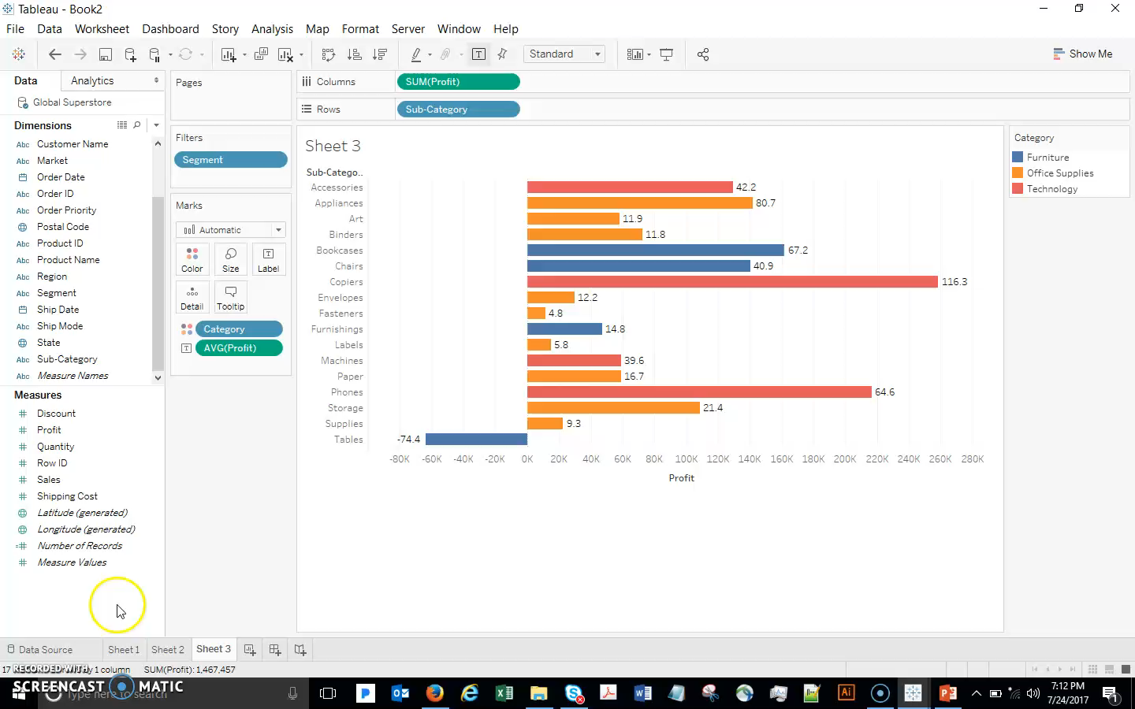
Legends

Slide 20
Paying Attention to Pill Color

Slide 21
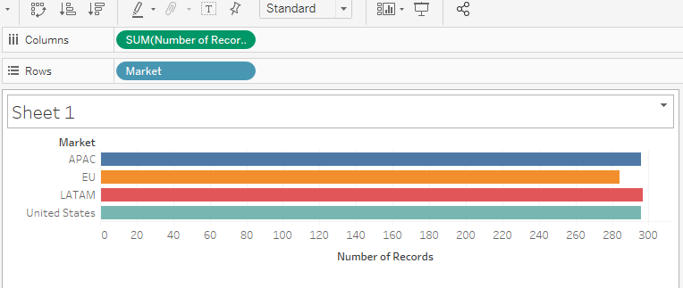
Paying Attention to Pill Color
When we bring a field into the view from the Data Window, Tableau creates a pill. The pill color indicates whether the pill is continuous or discrete. Discrete pills are BLUE, Continuous pills are GREEN.
Continuous
Discrete

Slide 22
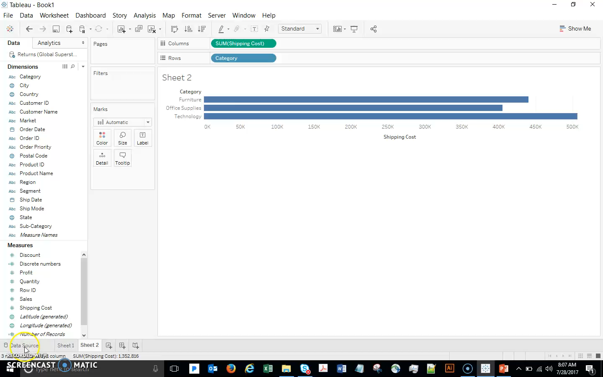
Paying Attention to Pill Color
Text and categories are inherently discrete. Numbers can also be discrete if they can only take one of a limited set of distinct, separate values. On the other hand, numbers are continuous if they can take on any value in a range.

Slide 23
Continuous vs. Discrete Dates

Slide 24
Continuous vs. Discrete Dates
With dates, it is very important to understand the difference between continuous and discrete, since dates can be brought into the view either way. If the date icon is blue in the data window, then the default when we bring out that pill will be discrete, otherwise it will be brought out as continuous
Useful trick: if we right click drag (option click drag on a Mac), we can select specifically what sort of date we want
Importantly, once a date is in the viz we can easily change its data type in the pill’s menu – you need to remember that the options on top are discrete dates, the lower section are continuous dates.

Slide 25
Continuous vs. Discrete Dates
Now show it both ways:
New sheet. Start by double-clicking Profit, then bringing Order Date to columns. We can see by the blue pill that this is a discrete date. This means that each part of the date is treated like a category. So when you drill down (click the + to expand to years and quarters), you have a separate section of the viz for each year, rather than one continuous line.
Discrete dates can be good because they allow you to treat each “date part” (year, month, etc.) as a separate variable. So, for example, if you want to filter sales by month (e.g. show me our sales in July), a discrete date works best.

Slide 26
Continuous vs. Discrete Dates
Now drag the Quarter pill out of the view so that you have only Year again. Right click and select the second year
You can see how the line now becomes continuous, and when you click the + it simply adds resolution rather than adding new pills (since each part of the date is not considered a category anymore.
For more info on continuous vs discrete dates, check out this link
http://sqlbelle.com/2015/01/29/do-you-know-how-dates-work-in-tableau-understanding-continuous-vs-discrete-dates/#more-2628

Slide 27
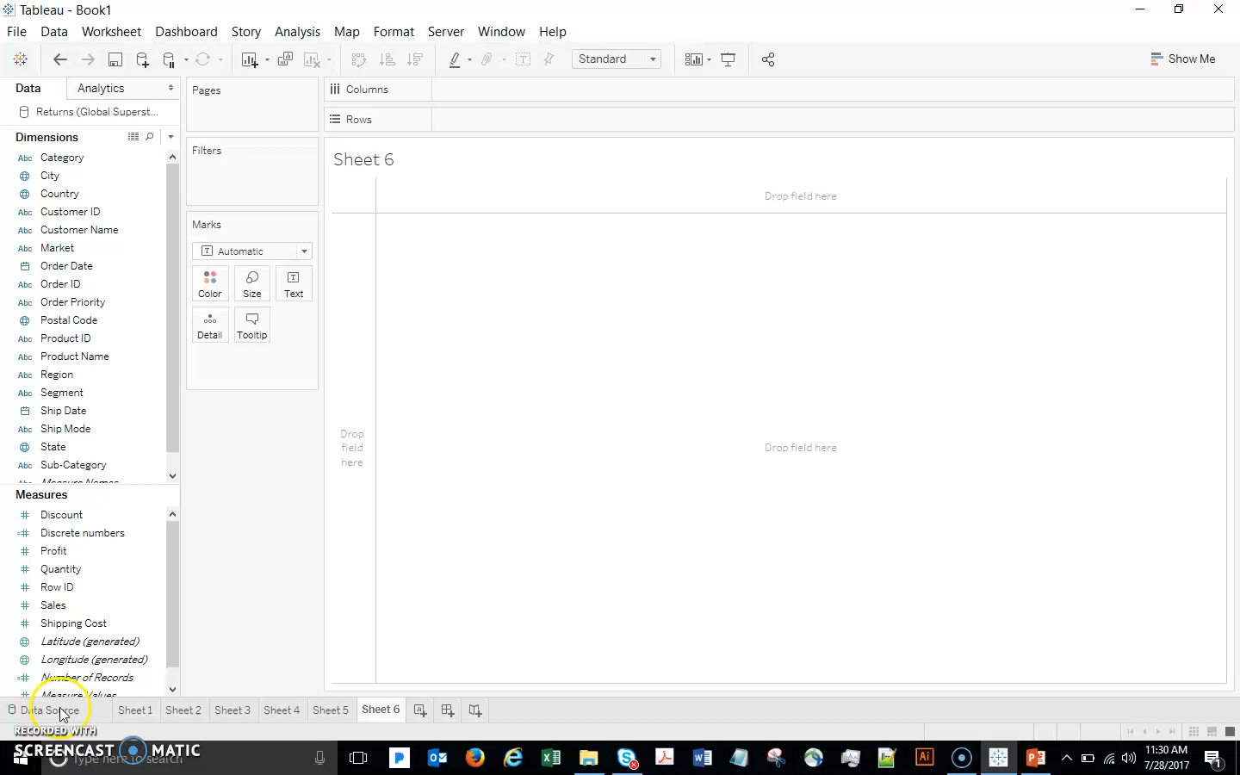
Continuous vs. Discrete Dates

Slide 28
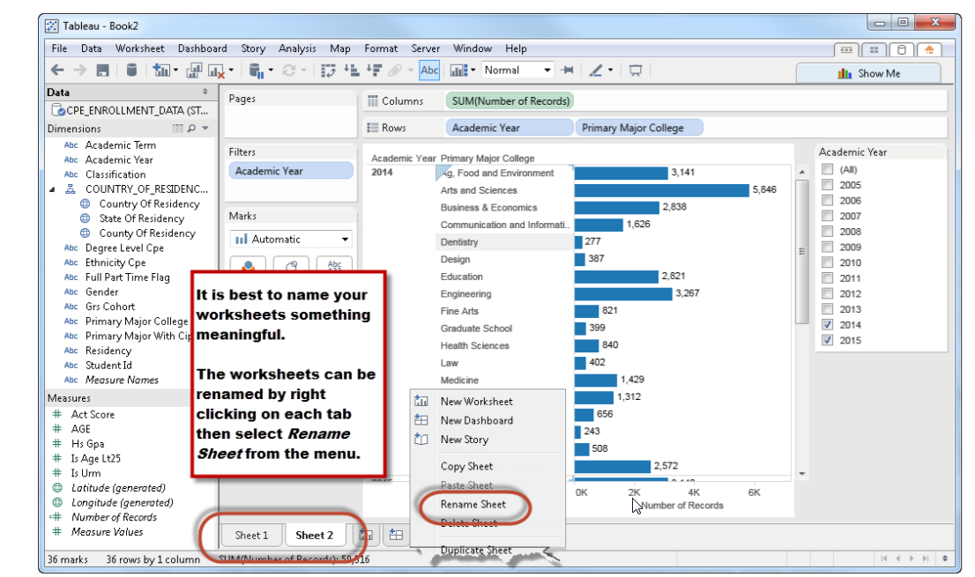
Remember

Slide 29
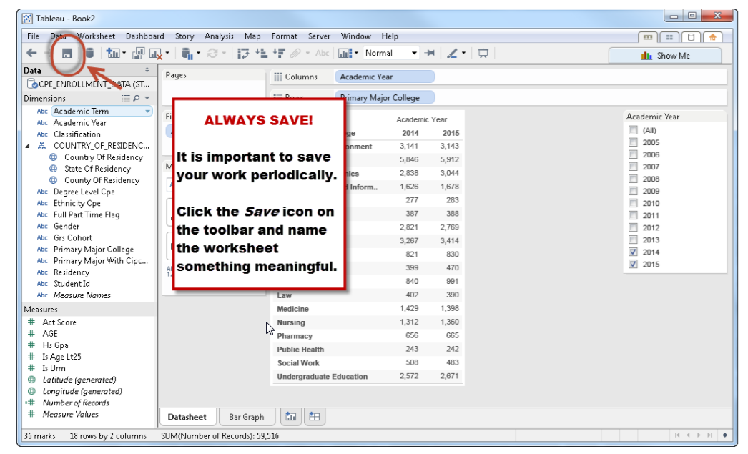
Remember

Slide 30
Lets try our first dashboard
Have a world map with country on one sheet
Use size to characterize Co2 emissions on the viz
On another sheet, plot for each country the co2 vs year
Now let’s create our dashboard

Slide 31
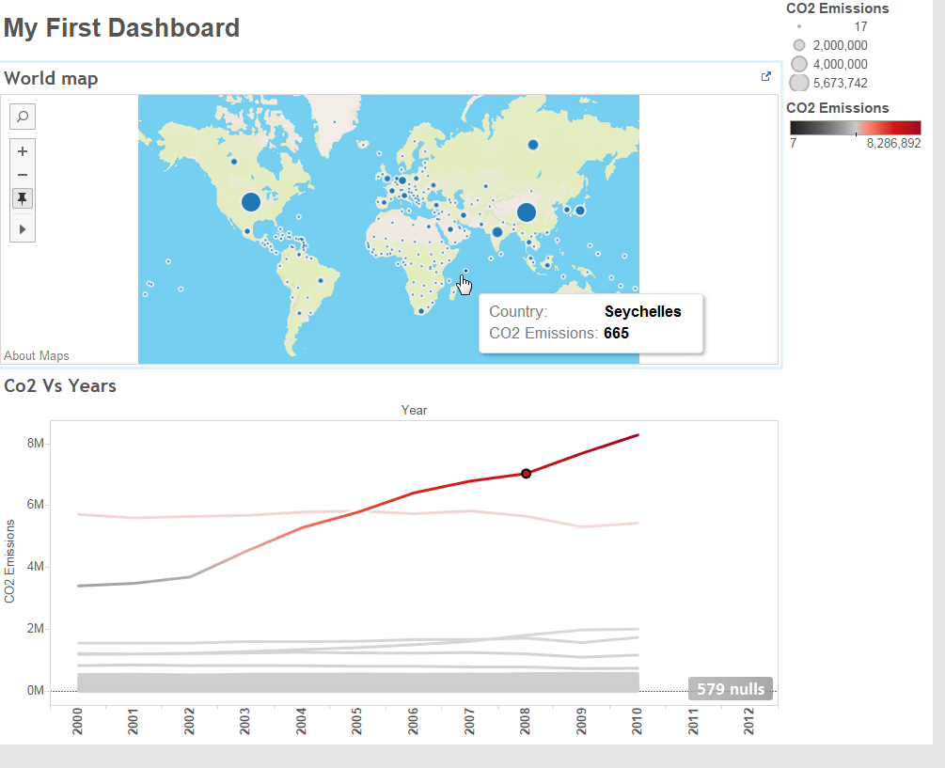

Slide 32
On a Dashboard
You can use one sheet to filter another
Do not forget to add titles to your dashboard and sheets
It is a good habit to name your sheets

Slide 33
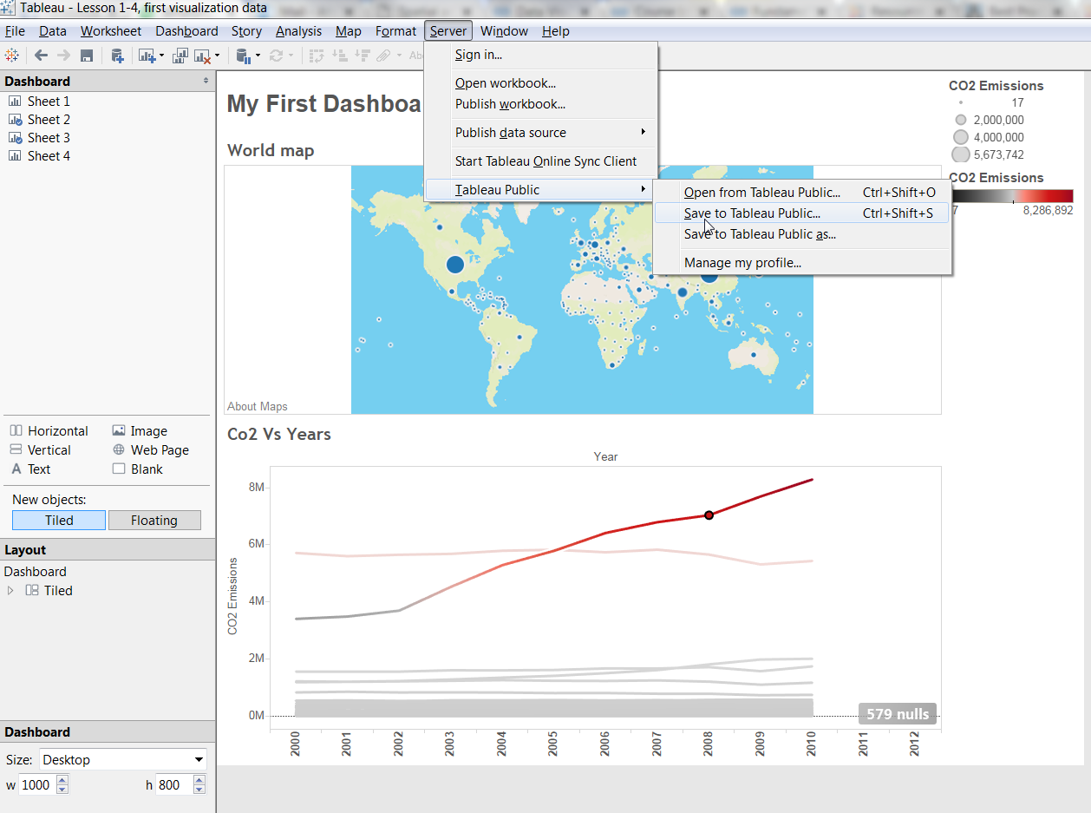
Publish your visualization
You can publish your visualization online on Tableau’s cloud from Tableau desktop
This can serve as your Tableau portfolio

Slide 34
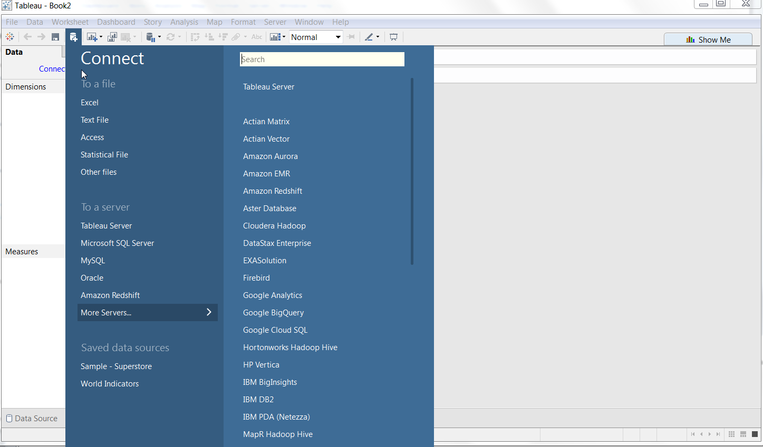
Import our first file

Slide 35
Connecting to the data source
It is called connecting (not opening) because Tableau does not change the original dataset
After importing your desired excel sheet, you get a preview of the first 1000 lines
Check the preview
Each column is one variable
First row is column headers
You can also check the type of the imported variable and see if it is interpreted correctly
Connecting to text files, help importing comma separated data like csv or tab (any delimiter) separated data
More data preparing and connecting will be discussed later

Slide 36
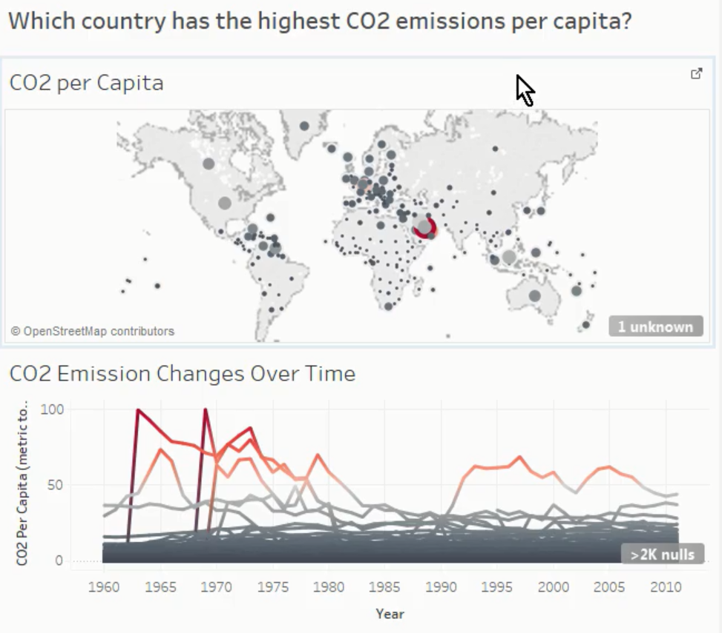
Exercise
Create the following dashboard for Co2 per capita

